Slide 1
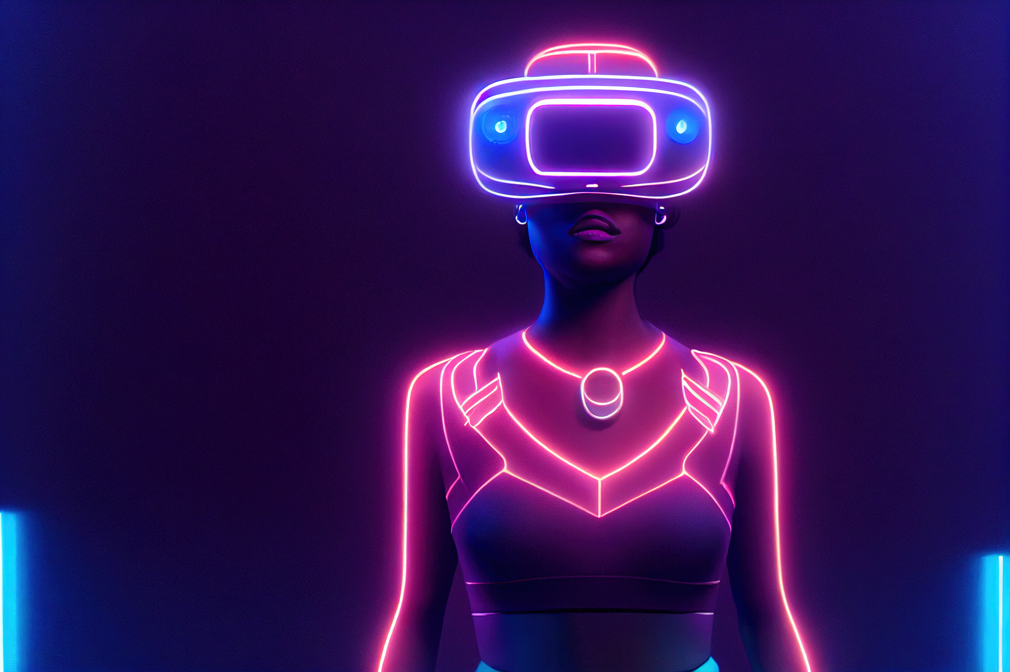
Virtual Reality
IRIS
A STEP INTO FUTURE
Group 15
Jahnvi Verma (202101200)
Dhyey Vachhani (202101190)
Samay Ashar (202001070)
Piyanshu Agrawal (202101093)
01
Mentor: Prof. Kalyan Sashidhar

Slide 2
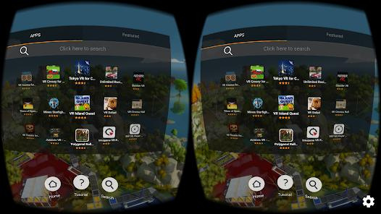
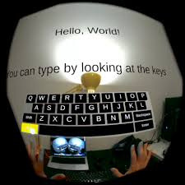
BASIC PROBLEM
Conventional typing using touchpad.
Existing apps have old, non-userfriendly UI
02

Slide 3
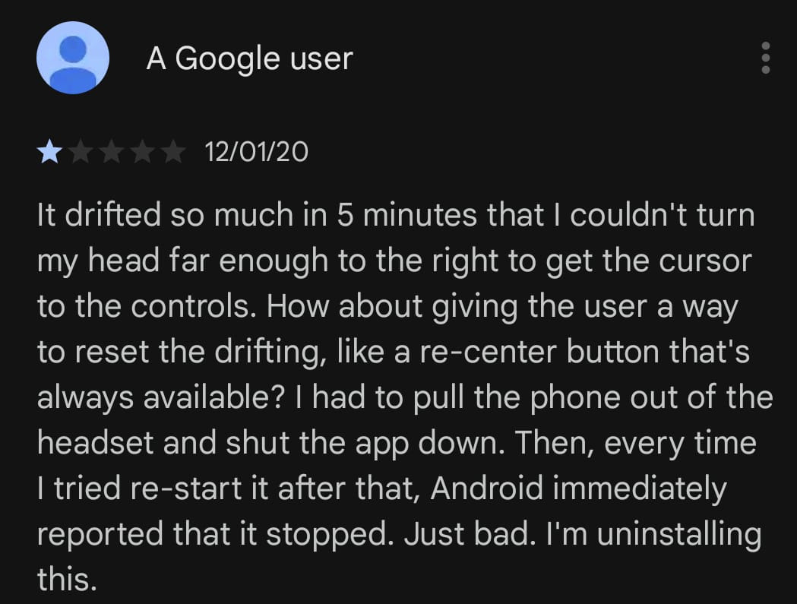
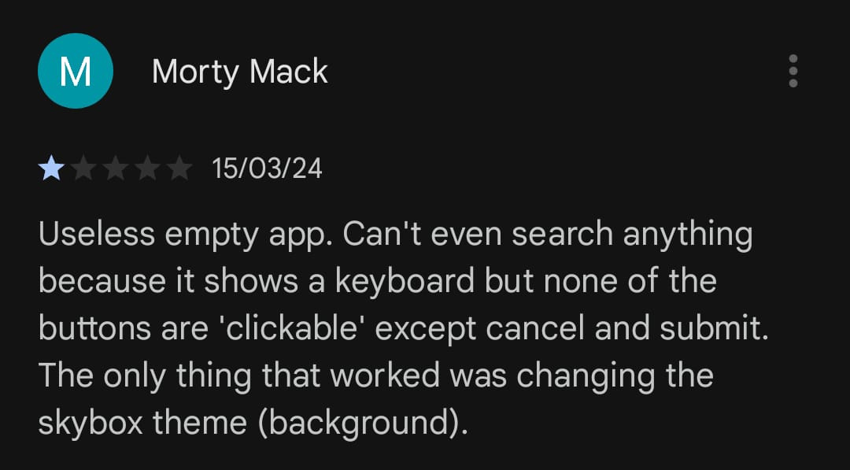
BASIC PROBLEM
Bad Reviews
02

Slide 4
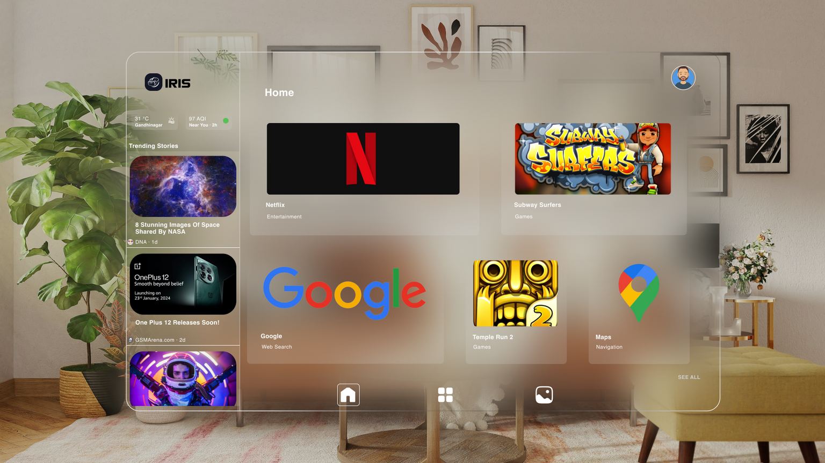
OUR SOLUTION
Designed IRIS - VR Interface using HCI principles:
Large icons of frequently used apps,
less cluttered, simple UI
Immersive experience of normal smartphone applications(VR supported) in a single app
03

Slide 5
OUR UI
KEY FEATURES

Slide 6

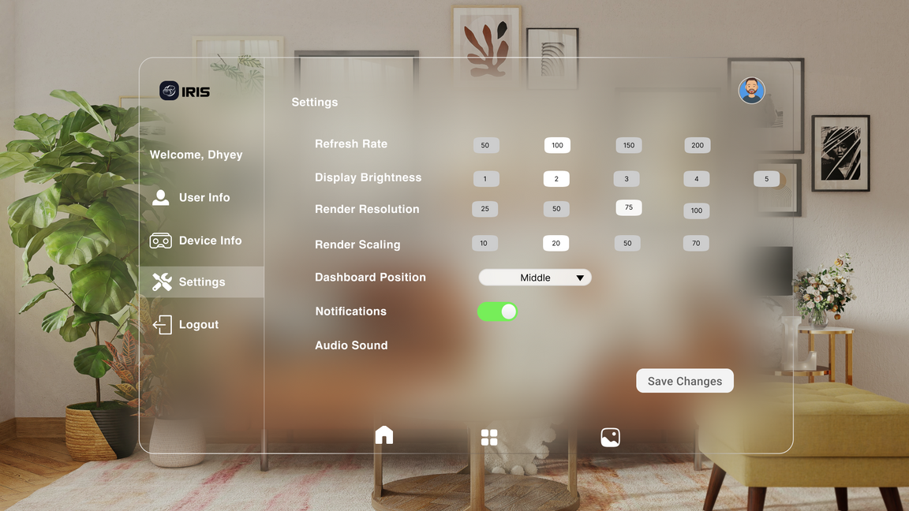
VALUE PROPOSITION
Slider
01
To enhance usability, we've replaced slider VR controls with discrete value options, simplifying selection for a smoother and more intuitive user experience.
07

Slide 7
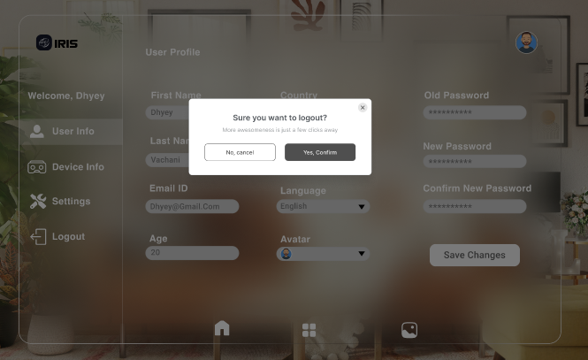
VALUE PROPOSITION
confirmation dialog
02
Unlike traditional apps, our app employs a confirmation dialogue for logging out, ensuring intentional actions and preventing accidental logouts.
07

Slide 8
VALUE PROPOSITION
Gester based typing
03
Conventional typing
07

Slide 9
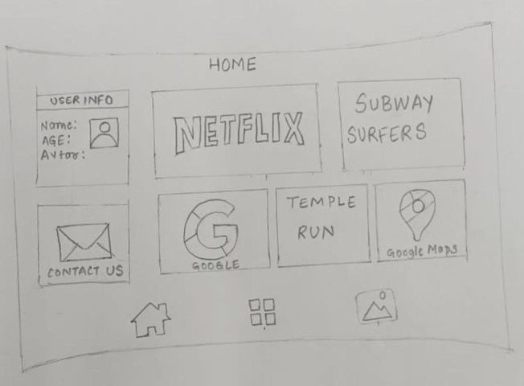
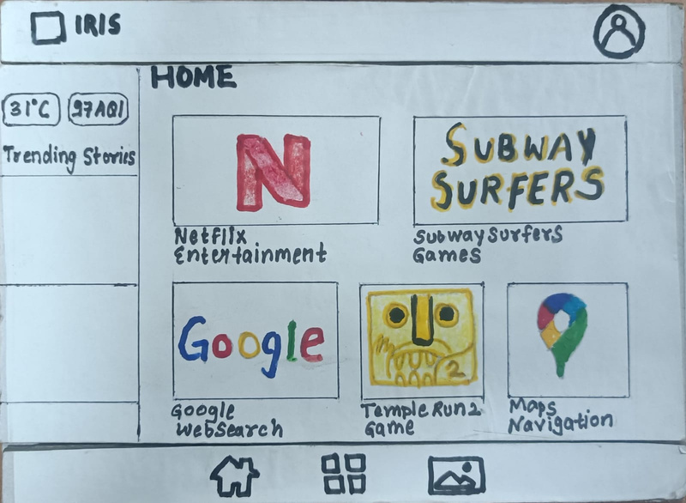
DESIGN ITERATION
04

Slide 10
CONCLUSION
05

